Slide 1
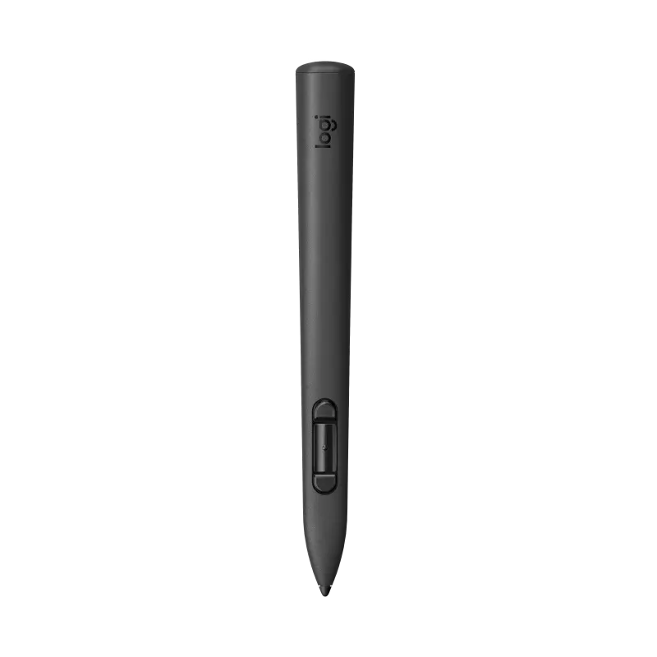
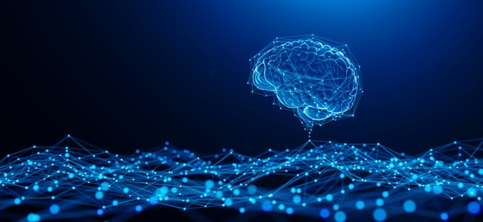
Neuro Sketch
XR 2.0
LOGITECH DEVSTUDIO CHALLENGE 2025 • STYLUS IN XR CATEGORY
"Not just a training tool.
A new way humanity understands the brain."
The World's First AI-Powered Mixed Reality
Neurosurgical Intelligence Platform
TEAM LOGIC WAALE
February 2025

Slide 2

THE CRISIS
THE SILENT CRISIS
INSIDE MEDICINE
250,000
7+
98%
Americans die annually
Years of residency
of medical XR apps
from preventable medical
errors — many traced to
inadequate surgical training
before a neurosurgery
resident touches a real
brain independently
use game controllers —
not precision instruments.
Like painting with a brick.
Source: Institute of Medicine
Source: ACGME Training Data
Source: XR Health Market Survey
"We send pilots into simulators before they fly.
We send surgeons into real brains with a textbook and a prayer."

Slide 3
WHY NOTHING HAS FIXED THIS YET
THE OLD WAY
WHAT'S ACTUALLY NEEDED
✗
2D textbooks and flat anatomical diagrams
✓
3D spatial hands-on interaction
✗
Cadavers — static, expensive,
cannot bleed or show disease progression
✓
Living physiology that responds
to touch in real time
✗
Plastic mannequins — zero realism,
zero complication response
✓
Pressure-sensitive instrument feel
that mimics real surgical tools
✗
VR apps with game controllers
"Like learning surgery with a TV remote"
✓
A tool that feels like a scalpel —
not a joystick
✗
Geography-locked training
Rural med schools have nothing at all
✓
Global access — zero geography barrier
for every student on Earth
The missing piece was never the software. It was the right hardware.

Slide 5
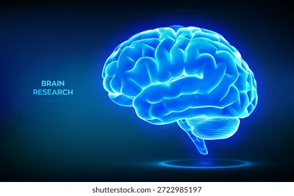
INTRODUCING
NeuroSketch XR 2.0
🔬
⚔️
🤝
LEARN
SIMULATE
COLLABORATE
Explore the living brain
at any scale — hemisphere
to individual synapse
Practice real procedures
with AI that thinks,
bleeds, and surprises you
Train with experts
anywhere on Earth in
shared MR space
"Where the MX Ink stylus becomes
the world's most sophisticated virtual surgical instrument."

Slide 6
FIVE PILLARS. ONE PLATFORM. ZERO COMPETITORS.
🔬
NEURAL EXPLORER
Zoom from hemisphere to synapse. The first dynamically alive brain in mixed reality. Bioluminescent neural firing. Personal MRI import.
The Living Brain Atlas
⚔️
SURGICAL SIMULATOR
12 full procedures. Pressure-mapped tissue across 14 types. AI complications. Ghost Surgeon overlay. Consequence visualization.
MX Ink = Scalpel
🤝
GLOBAL OR
6 users. Any city. One shared holographic brain. Role-based team simulation. AXON AI Socratic Mentor.
Collaborative MR
🤖
PATHOPHYSIOLOGY AI
Paint disease. Watch it grow in real time. Treat it. See consequences. 8 conditions simulated.
The Brain That Gets Sick
🎮
MASTERY SYSTEM
Surgical passport. Global leaderboards. Adaptive AI difficulty. Never boring. Never overwhelming.
Learning as a Game

Slide 7
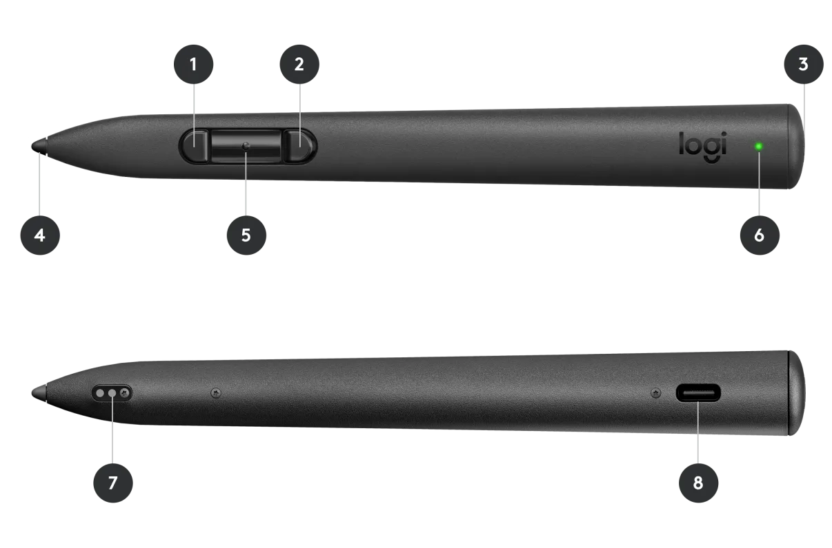
EVERY COMPETITOR BUILT FOR CONTROLLERS.
We built for this.
PRECISION TIP
Sub-millimeter accuracy
Ghost surgeon deviation scored in real millimeters
4,096 PRESSURE LEVELS
Light → surface annotation
Medium → fascial dissection
Heavy → bone cut simulation
TILT DETECTION 0°–60°
Flat = spatula retractor
Upright = bipolar forceps
Angle = instrument identity
SIDE BUTTON MODES
1× = Annotate mode | 2× = Dissect mode
Hold = Paint pathology | Double tap = Hand switch
Feature | Game Controller | MX Ink Stylus
Pressure Sensitivity | ✗ None | ✓ 4,096 levels
Tilt Awareness | ✗ None | ✓ 0–60° detection
Surgical Feel | ✗ Button pressing | ✓ Natural pen grip
Precision | ✗ Centimeter-level | ✓ Sub-millimeter
Skill Transfer | ✗ Zero | ✓ Direct motor memory

Slide 8
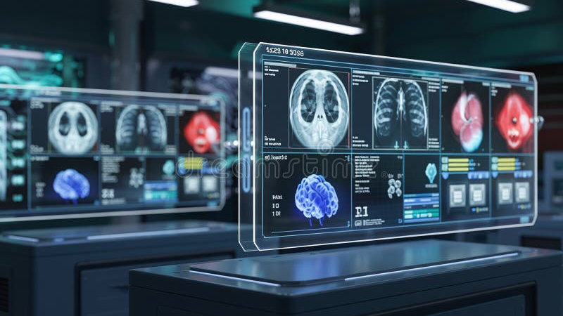
LIVE DEMONSTRATION
"This is what learning
neurosurgery feels like
in 2025."
Pressure-mapped tissue response — LIVE
AXON AI Mentor — responding in real time
Ghost Surgeon overlay — expert path visible

Slide 9

A $22 BILLION MARKET
WAITING FOR THIS MOMENT
🏫
170+ US Medical Schools
× avg 10 seats = 1,700 institutional seats immediately
🏥
6,500+ US Hospitals
Neurosurgery + pre-operative planning market
TAM
SAM
SOM
$22B
$4.2B
💊
$4B Pharma Training Annual Spend
$11.45M
Year 3
Conservative ARR
Neurological drug reps — highest possible margins
Neuro Training
+ Pharma XR
Global Medical
Simulation
⚖️
Forensic Legal Reconstruction
$800M expert witness testimony industry
🎓
Pre-Med + High School Education
NeuroSketch Academy tier — 40M+ global students
"Every zip code that has a medical school is our customer. That's 3,000+ institutions globally."

Slide 10
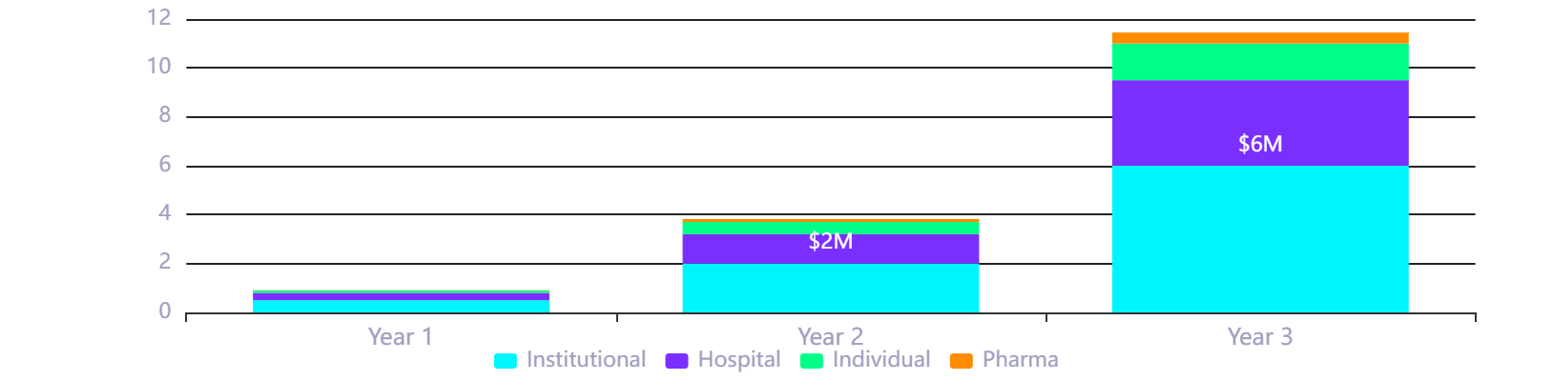
BUILT TO SCALE — FIVE REVENUE STREAMS
Predictable. Defensible.
★ MOST POPULAR
HOSPITAL
PHARMA
RESIDENT
INSTITUTIONAL
CLINICAL
CUSTOM
INDIVIDUAL
FELLOW
$3,500
$15,000
$50,000+
$19
$49
/year per seat
/year
/module
/month
/month
• All Features
• DICOM Import
• Bespoke Disease Sim
• Anatomy Explorer
• Full Library
• LMS Integration
• Pre-Op Planning
• White-Label Branding
• 3 Procedures
• Ghost Surgeon
• Analytics Dashboard
• EHR Integration
• Custom Procedures
• Dashboard
• AXON Mentor
• Accreditation Reports
• HIPAA Storage
• Zero Marginal Cost
• Leaderboard
• Surgical Passport
• Grand Rounds Hosting
• Patient Consent Tool
• Pure Margin Revenue
REVENUE PROJECTION (ARR)
WHY THIS IS SAFE:
→
B2B institutional = low churn
→
Pharma modules = enterprise ceiling
→
Multiple streams = recession-proof
→
Zero marginal cost on modules

Slide 11

PRODUCTION-GRADE ARCHITECTURE
Built to ship. Built to scale.
TECH STACK
🖊️ MX Ink Stylus
🥽 Meta Quest 3
USER LAYER
Unity 2023
Meta XR SDK
• 4,096 pressure levels
• Unity 2023 LTS + URP
• Tilt detection 0–60°
• Meta Presence Platform
MX Ink SDK
PyTorch
• Side button mode cycling
• MR Passthrough rendering
FastAPI
Photon Fusion
• Sub-mm position tracking
• 90Hz display sync
AWS
3D Slicer
WebSocket / REST API ↓
OpenXR
AXON AI Mentor
Pathophysiology Engine
Fine-tuned LLM
Socratic Q&A system
Learner profile builder
PyTorch tumor/stroke models
Disease sandbox renderer
Treatment response AI
AI LAYER
Procedure Scorer
Adaptive Difficulty
Ghost path deviation
Scored in millimeters
Real-time feedback
10-session rolling avg
Complication probability tuner
Never bored / overwhelmed
AWS API Gateway ↓
AWS S3 HIPAA
Photon Fusion
3D Slicer Pipeline
INFRA
DICOM storage
HIPAA compliant
EHR integration
6-user real-time
90Hz sync
<20ms latency
DICOM → 3D mesh
Auto-segmentation
<4 min processing
MVP IN 6 WEEKS:
Wk 1–2
Foundation + MX Ink SDK
→
Wk 3
Tissue Engine
→
Wk 4
AXON System
→
Wk 5
Full Procedure
→
Wk 6
Polish + Demo

Slide 12
JUDGED ON FOUR CRITERIA.
DOMINANT ON ALL FOUR.
🔭
NOVELTY
💥
IMPACT
⭐⭐⭐⭐⭐ 10/10
⭐⭐⭐⭐⭐ 10/10
"Zero direct competitors combine pressure-sensitive stylus input with AI pathophysiology and collaborative MR neurosurgery.
"Addresses 250,000 preventable deaths annually. Reaches every medical school on Earth.
We are the only one."
This is a mission, not a product."
📈
VIABILITY
✨
UX QUALITY
⭐⭐⭐⭐½ 9/10
⭐⭐⭐⭐⭐ 10/10
"Multi-tier SaaS. B2B institutional anchoring. Pharma as enterprise safety net. $11.45M ARR Year 3.
"Every interaction is MX Ink native. The stylus is not an accessory.
Five revenue streams. Low churn."
It IS the entire product."
"Every other medical XR app gave surgeons a game controller. We gave them a scalpel."

Slide 13
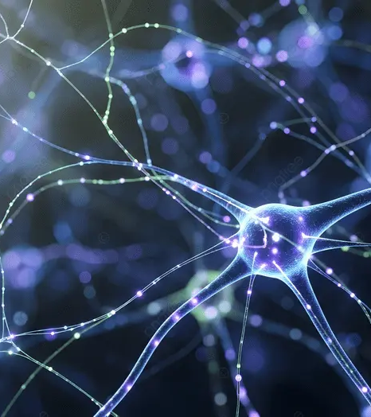
A medical student in rural Nigeria.
A resident at Johns Hopkins.
Practicing the same procedure.
On the same holographic brain.
Guided by the same AI mentor.
For the first time —
zip code does not
determine surgical
competence.
WHAT WE'RE ASKING FOR
WHAT LOGITECH GAINS
→
Top 50 selection
→
The defining medical use case for MX Ink
→
Logitech MX Ink + Quest 3 hardware
→
Expert mentorship access
→
Reach into 40M+ users via med schools
→
6 weeks to build the future of medicine
→
A partnership that literally saves human lives
→
The story that defines MX Ink forever
NeuroSketch XR 2.0
"Train like a surgeon. Think like a scientist. Save lives."
[Team Name] | [Email] | [DevPost Profile URL]

